Slide 1
Traffic collisions data analysis
Capstone project of Applied Data Science specialisation on Coursera
Alexey Reznik
2020

Slide 2
Table of contents
Introduction and Data
Exploratory Data Analysis
Inferential statistics
Results

Slide 3
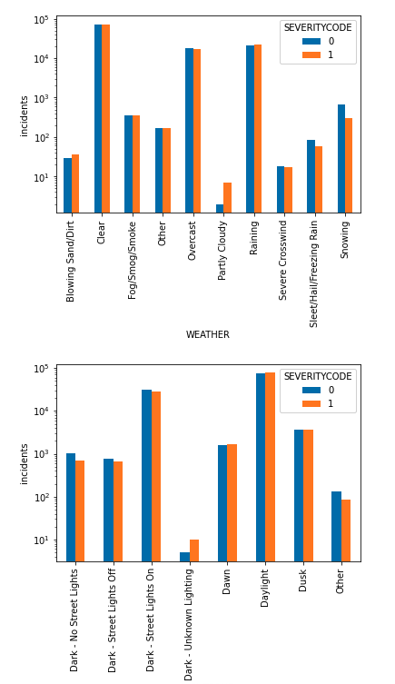
Exploratory Data Analysis 2/3
Incidents that have happened in partly cloudy weather and on the dark road with unknown lighting statistically tend to be more severe

Slide 4
Introduction and Data
Goal: build a machine learning based system that can predict severity of a car accident based on a variety of known attributes of an accident and conditions under which the accident has occurred
Interest: insurance companies, police department traffic management divisions or any other party interested in analysing labeled incident data to make certain conclusions
Data: collision records provided by Seattle Police Department with a total of a little less than 200 000 records and span in a timeframe from 2004 till 2020

Slide 5
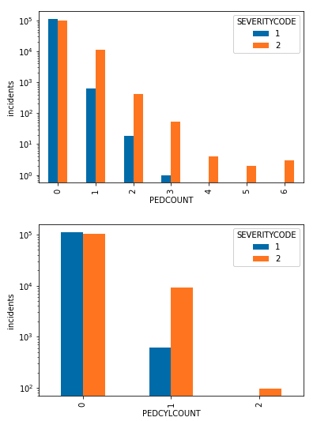
Exploratory Data Analysis 1/3
Number of cyclists and pedestrians involved in an incident significantly increases the probability of higher incident severity
Severity codes:
1 - property damage
2 - injury

Slide 6
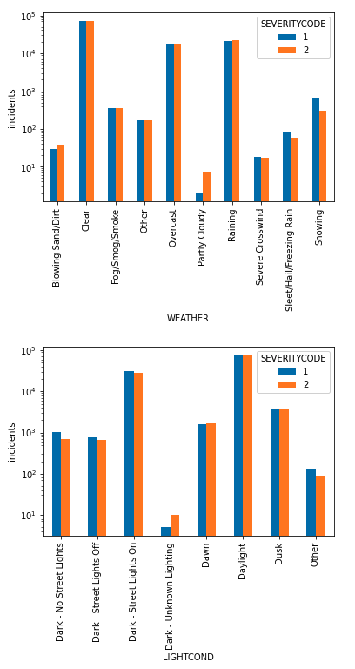
Exploratory Data Analysis 2/3
Incidents that have happened in partly cloudy weather and on the dark road with unknown lighting statistically tend to be more severe

Slide 7
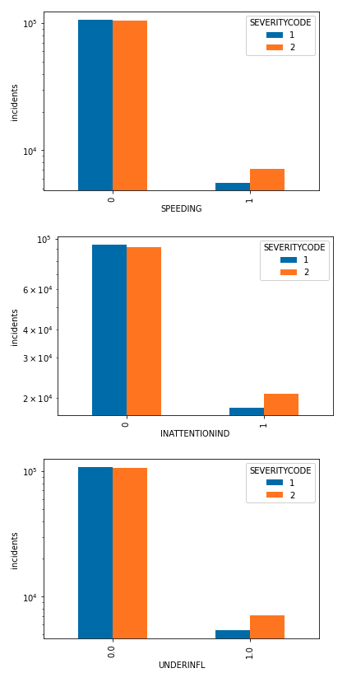
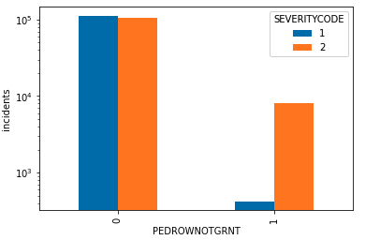
Exploratory Data Analysis 3/3
Not giving a pedestrian the right of way is major factor increasing the probability of an accident being severe
Speeding, driving under influence and inattentive driving also significantly increase the severity

Slide 8
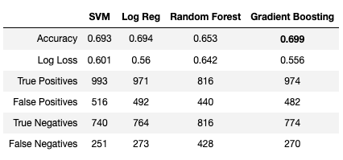
Inferential statistics
The following classification models have been applied:
Support Vector Machine
Logical Regression
Random Forest
Gradient Boosting
Gradient Boosting showed best results in terms of accuracy - 0.699

Slide 9
Results
The following factors have been identified as most critical to the severity of an incident:
pedestrians involved
cyclists involved
partly cloudy weather
dark lighting
pedestrian right of way not been granted
speeding
inattention
driving under influence
Inferential model was built using Gradient Boosting classifier and showed 69.9% accuracy

